Slide 1
CAR #133911505 Analysis for CAR Calibration Meeting
By Jacky Wu

Slide 2
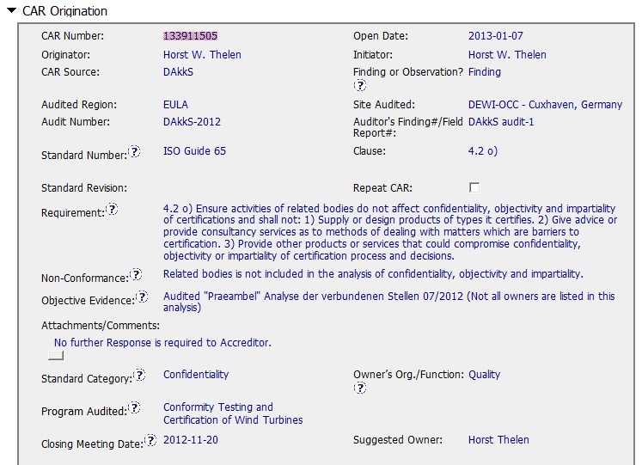
CAR No. 133911505 (1)

Slide 3
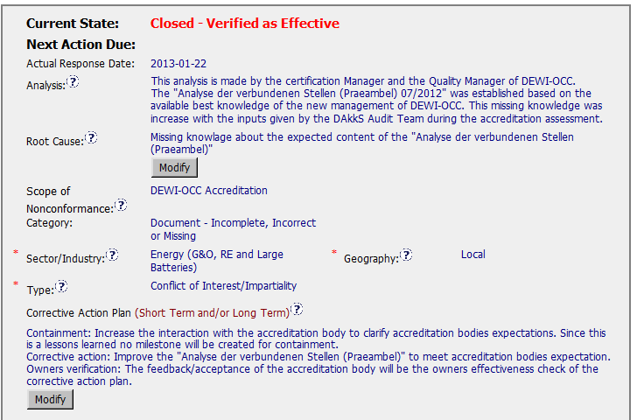
CAR No. 133911505 (2)
The root analysis is incomplete, which looks like a problem statement instead of root cause analysis. i.e. why the knowledge was missing during the process establishment? In addition, is there any impact for the missing of analysis of confidentiality, objectivity and impartiality? The further reason and scope should be investigated.
The scope addressed here is not appropriate. Since the root cause analysis is not complete, the nonconformance locations, affected processes, departments, people, etc. could not be determined.
No further comments with these sections. However, the “Geography” may be different when the further scope investigation is done.
* Suggestion: The options in the field of “Category” and “Type” may need to be further reviewed and revised, if necessary. Since the current options in the database are mainly focusing the processes of Product Safety. But the other BUs may have different processes from Product Safety, which will have the different “Category” and “Type”, but it is not available in the current database.
Notes:
00-QA-S0006 (#18.0) - Corrective Action Request Process

Slide 4
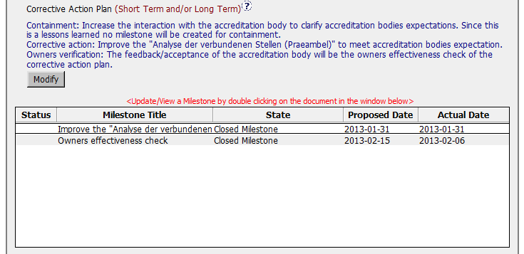
CAR No. 133911505 (3)
The additional containment action milestone can still be added, e.g. revise the “Praeambel" Analyse der verbundenen Stellen to include the analysis of confidentiality, objectivity and impartiality (just like the milestone of the corrective action addressed in the CAR).
The corrective action addressed in this CAR is just a containment action as mentioned above. It does not address how to prevent the similar knowledge missing in future based on the root cause addressed. One suggestion is to further deploy the “Containment” that, how to increase the interaction with the accreditation body to get timely update for the accreditation expectations and how to ensure the revised the processes/documents are implemented effectively.
The “Verification” should not only rely on the acceptance from the accreditation body, but also include the verification on how the revised the processes/documents are implemented effectively, e.g. whether the analysis of confidentiality, objectivity and impartiality has been conducted and how the discrepancies found were handled, etc.
Notes:
00-QA-S0006 (#18.0) - Corrective Action Request Process

Slide 5
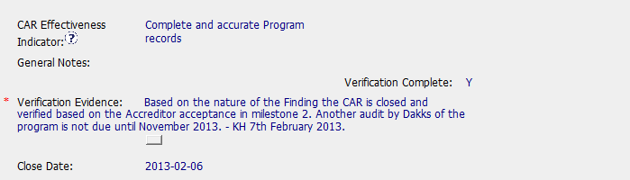
CAR No. 133911505 (4)
Again, the CAR Effectiveness Indicator and Verification should should not only rely on the revised documents and the acceptance from the accreditation body, but also include the verification on how the revised the processes/documents are implemented effectively, e.g. whether the analysis of confidentiality, objectivity and impartiality has been conducted and how the discrepancies found were handled, etc.
Notes:
00-QA-S0006 (#18.0) - Corrective Action Request Process

Slide 6
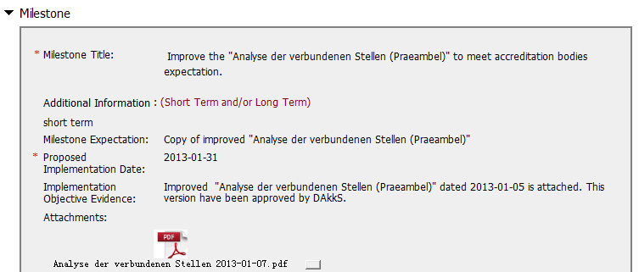
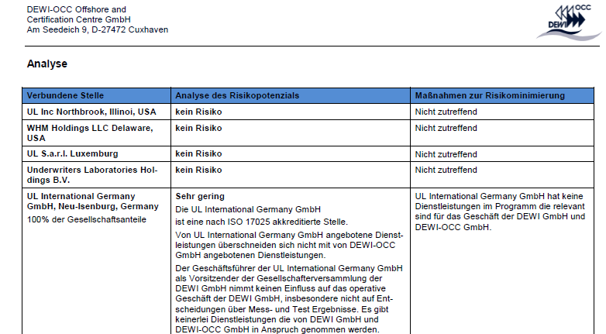
CAR No. 133911505 (5)
Besides the comments of the containment/corrective actions addressed in the previous slides, it is suggested that the implementation objective evidences could be written/translated into English. No comments could be provided now since the document is written in German.
Notes:
00-QA-S0006 (#18.0) - Corrective Action Request Process

Slide 7
Review CAR 133911505

Slide 8
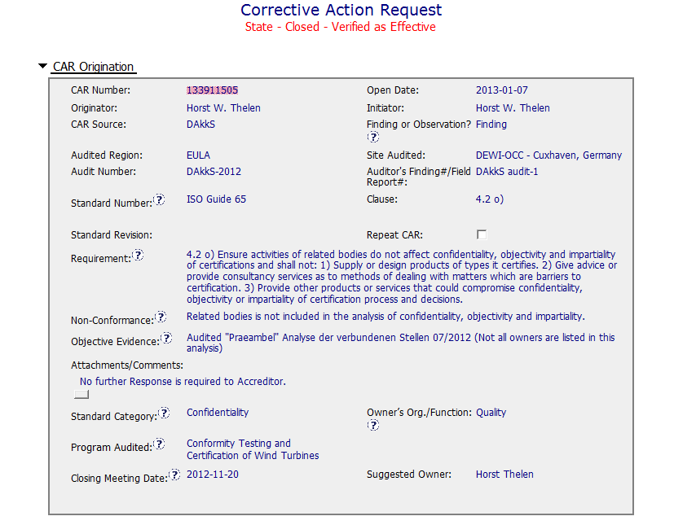
CAR review – 133911505
Improvement – add explanation so that the exact issue is clear to those reading the CAR.
Accreditor status included

Slide 9
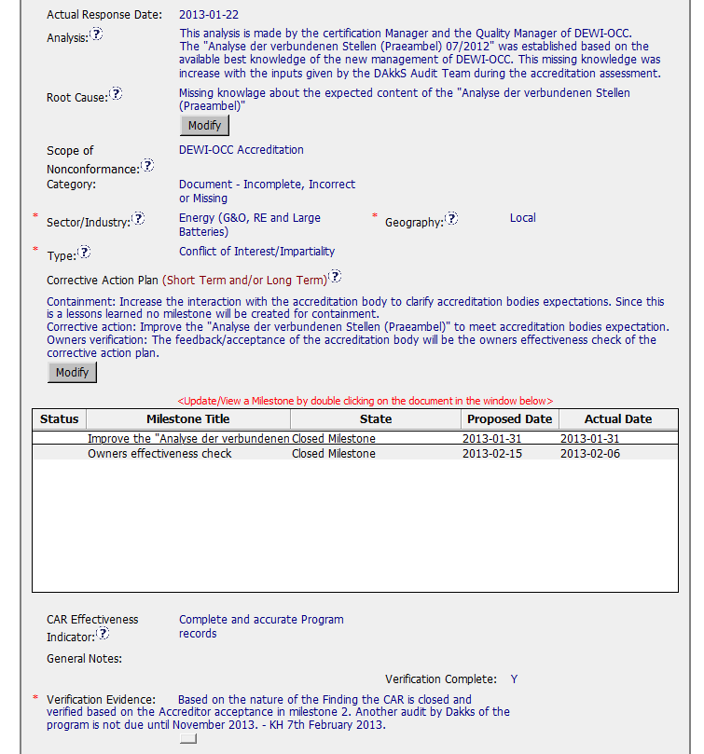
CAR – 133911505
Stakeholders identified
Improvement – add employee numbers for traceability
Included details of Dakks expectations
Improvement – could confirm who was
present to receive the information from Dakks
Scope of CAR identified by field
Explanation provided for lack of a
containment milestone.
Improvement – Describe the improvements to be made to the analysis
Rationale provided for Verification

Slide 10
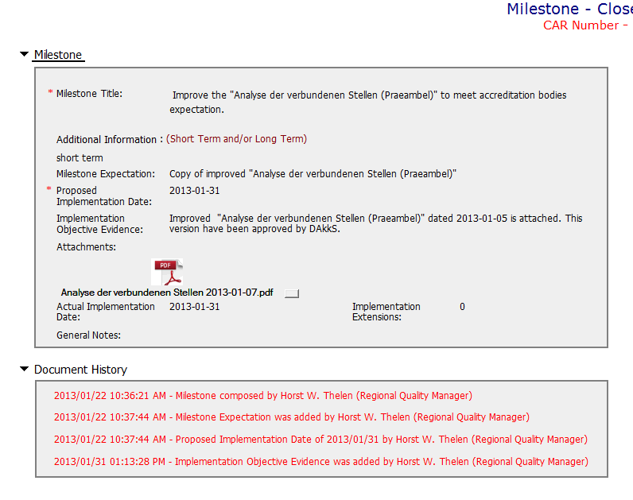
CAR – 133911505
Improvements:
– Describe the Improvements to be made to the analysis

Slide 11
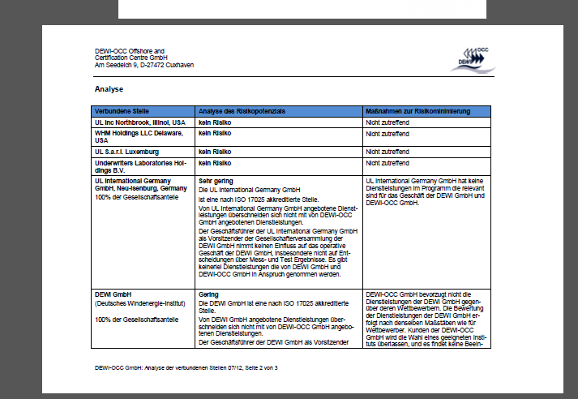
CAR – 133911505
Improvements:
- Provide English language translation of improvements/changes made for traceability

